Slide 1
Python

Slide 2
Python Sets
Set
A set is a collection which is unordered and unindexed. In Python sets are written with curly brackets.
Example
Create a Set:
thisset = {"apple", "banana", "cherry"}
print(thisset)

Slide 3
Python Sets
Access Items
You cannot access items in a set by referring to an index, since sets are unordered the items has no index.
But you can loop through the set items using a for loop, or ask if a specified value is present in a set, by using the in keyword.
Example
Loop through the set, and print the values:
thisset = {"apple", "banana", "cherry"}
for x in thisset:
print(x)

Slide 4
Python Sets
Example
Check if "banana" is present in the set:
thisset = {"apple", "banana", "cherry"}
print("banana" in thisset)

Slide 5
Python Sets
Change Items
Once a set is created, you cannot change its items, but you can add new items.
Add Items
To add one item to a set use the add() method.
To add more than one item to a set use the update() method.

Slide 6
Python Sets
Example
Add an item to a set, using the add() method:
thisset = {"apple", "banana", "cherry"}
thisset.add("orange")
print(thisset)

Slide 7
Python Sets
Example
Add multiple items to a set, using the update() method:
thisset = {"apple", "banana", "cherry"}
thisset.update(["orange", "mango", "grapes"])
print(thisset)

Slide 8
Python Sets
Get the Length of a Set
To determine how many items a set has, use the len() method.
Example
Get the number of items in a set:
thisset = {"apple", "banana", "cherry"}
print(len(thisset))

Slide 9
Python Sets
Remove Item
To remove an item in a set, use the remove(), or the discard() method.
Example
Remove "banana" by using the remove() method:
thisset = {"apple", "banana", "cherry"}
thisset.remove("banana")
print(thisset)

Slide 10
Python Sets
Note: If the item to remove does not exist, remove() will raise an error.
Example
Remove "banana" by using the discard() method:
thisset = {"apple", "banana", "cherry"}
thisset.discard("banana")
print(thisset)

Slide 11
Python Sets
Note: If the item to remove does not exist, discard() will NOT raise an error.
You can also use the pop(), method to remove an item, but this method will remove the last item. Remember that sets are unordered, so you will not know what item that gets removed.
The return value of the pop() method is the removed item.
Example
Remove the last item by using the pop() method:
thisset = {"apple", "banana", "cherry"}
x = thisset.pop()
print(x)
print(thisset)

Slide 12
Python Sets
Note: Sets are unordered, so when using the pop() method, you will not know which item that gets removed.
Example
The clear() method empties the set:
thisset = {"apple", "banana", "cherry"}
thisset.clear()
print(thisset)

Slide 13
Python Sets
Example
The del keyword will delete the set completely:
thisset = {"apple", "banana", "cherry"}
del thisset
print(thisset)

Slide 14
Python Sets
Join Two Sets
There are several ways to join two or more sets in Python.
You can use the union() method that returns a new set containing all items from both sets, or the update() method that inserts all the items from one set into another:
Example
The union() method returns a new set with all items from both sets:
set1 = {"a", "b" , "c"}
set2 = {1, 2, 3}
set3 = set1.union(set2)
print(set3)

Slide 15
Python Sets
Example
The update() method inserts the items in set2 into set1:
set1 = {"a", "b" , "c"}
set2 = {1, 2, 3}
set1.update(set2)
print(set1)

Slide 16
Python Sets
Note: Both union() and update() will exclude any duplicate items.
There are other methods that joins two sets and keeps ONLY the duplicates, or NEVER the duplicates, check the full list of set methods in the bottom of this page.
The set() Constructor
It is also possible to use the set() constructor to make a set.
Example
Using the set() constructor to make a set:
thisset = set(("apple", "banana", "cherry")) # note the double round-brackets
print(thisset)

Slide 17
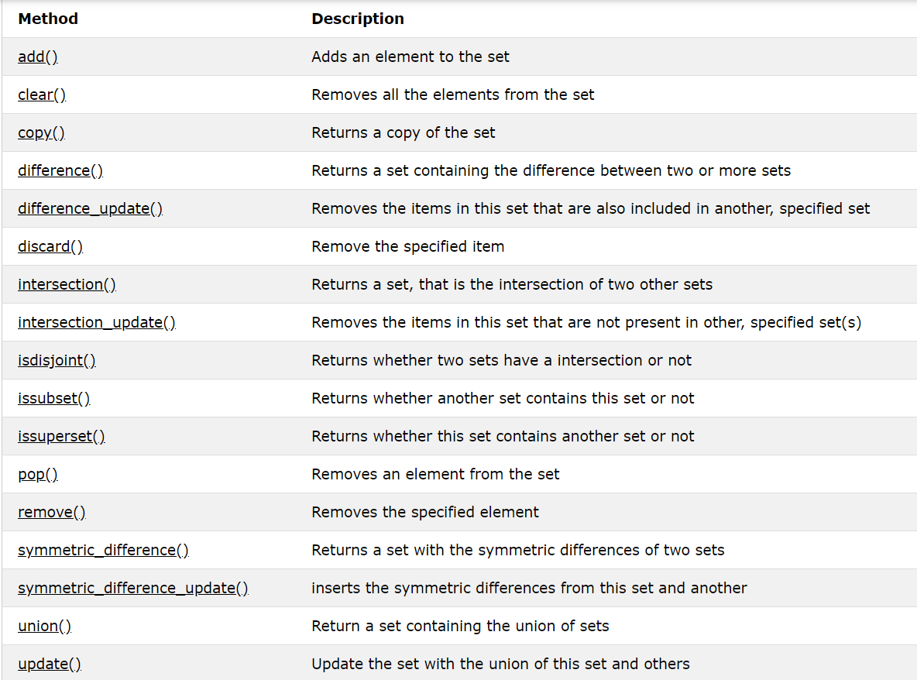
Python Sets
Set Methods
Python has a set of built-in methods that you can use on sets.

Slide 18
Python Dictionaries
Dictionary
A dictionary is a collection which is unordered, changeable and indexed. In Python dictionaries are written with curly brackets, and they have keys and values.
Example
Create and print a dictionary:
thisdict = {
"brand": "Ford",
"model": "Mustang",
"year": 1964
}
print(thisdict)

Slide 19
Python Dictionaries
Accessing Items
You can access the items of a dictionary by referring to its key name, inside square brackets:
Example
Get the value of the "model" key:
x = thisdict["model"]
There is also a method called get() that will give you the same result:
Example
Get the value of the "model" key:
x = thisdict.get("model")

Slide 20
Python Dictionaries
Change Values
You can change the value of a specific item by referring to its key name:
Example
Change the "year" to 2018:
thisdict = {
"brand": "Ford",
"model": "Mustang",
"year": 1964
}
thisdict["year"] = 2018

Slide 21
Python Dictionaries
Loop Through a Dictionary
You can loop through a dictionary by using a for loop.
When looping through a dictionary, the return value are the keys of the dictionary, but there are methods to return the values as well.
Example
Print all key names in the dictionary, one by one:
for x in thisdict:
print(x)

Slide 22
Python Dictionaries
Example
Print all values in the dictionary, one by one:
for x in thisdict:
print(thisdict[x])
Example
You can also use the values() method to return values of a dictionary:
for x in thisdict.values():
print(x)
Example
Loop through both keys and values, by using the items() method:
for x, y in thisdict.items():
print(x, y)

Slide 23
Python Dictionaries
Check if Key Exists
To determine if a specified key is present in a dictionary use the in keyword:
Example
Check if "model" is present in the dictionary:
thisdict = {
"brand": "Ford",
"model": "Mustang",
"year": 1964
}
if "model" in thisdict:
print("Yes, 'model' is one of the keys in the thisdict dictionary")

Slide 24
Python Dictionaries
Dictionary Length
To determine how many items (key-value pairs) a dictionary has, use the len() function.
Example
Print the number of items in the dictionary:
print(len(thisdict))

Slide 25
Python Dictionaries
Adding Items
Adding an item to the dictionary is done by using a new index key and assigning a value to it:
Example
thisdict = {
"brand": "Ford",
"model": "Mustang",
"year": 1964
}
thisdict["color"] = "red"
print(thisdict)

Slide 26
Python Dictionaries
Removing Items
There are several methods to remove items from a dictionary:
Example
The pop() method removes the item with the specified key name:
thisdict = {
"brand": "Ford",
"model": "Mustang",
"year": 1964
}
thisdict.pop("model")
print(thisdict)

Slide 27
Python Dictionaries
Example
The popitem() method removes the last inserted item (in versions before 3.7, a random item is removed instead):
thisdict = {
"brand": "Ford",
"model": "Mustang",
"year": 1964
}
thisdict.popitem()
print(thisdict)
The del keyword removes the item with the specified key name:
thisdict = {
"brand": "Ford",
"model": "Mustang",
"year": 1964
}
del thisdict["model"]
print(thisdict)

Slide 28
Python Dictionaries
Example
The del keyword can also delete the dictionary completely:
thisdict = {
"brand": "Ford",
"model": "Mustang",
"year": 1964
}
del thisdict
print(thisdict) #this will cause an error because "thisdict" no longer exists.

Slide 29
Python Dictionaries
Example
The clear() method empties the dictionary:
thisdict = {
"brand": "Ford",
"model": "Mustang",
"year": 1964
}
thisdict.clear()
print(thisdict)

Slide 30
Python Dictionaries
Copy a Dictionary
You cannot copy a dictionary simply by typing dict2 = dict1, because: dict2 will only be a reference to dict1, and changes made in dict1 will automatically also be made in dict2.
There are ways to make a copy, one way is to use the built-in Dictionary method copy().
Make a copy of a dictionary with the copy() method:
thisdict = {
"brand": "Ford",
"model": "Mustang",
"year": 1964
}
mydict = thisdict.copy()
print(mydict)

Slide 31
Python Dictionaries
Another way to make a copy is to use the built-in function dict().
Example
Make a copy of a dictionary with the dict() function:
thisdict = {
"brand": "Ford",
"model": "Mustang",
"year": 1964
}
mydict = dict(thisdict)
print(mydict)

Slide 32
Python Dictionaries
Create three dictionaries, then create one dictionary that will contain the other three dictionaries:
child1 = {
"name" : "Emil",
"year" : 2004
}
child2 = {
"name" : "Tobias",
"year" : 2007
}
child3 = {
"name" : "Linus",
"year" : 2011
}
myfamily = {
"child1" : child1,
"child2" : child2,
"child3" : child3
}

Slide 33
Python Dictionaries
The dict() Constructor
It is also possible to use the dict() constructor to make a new dictionary:
Example
thisdict = dict(brand="Ford", model="Mustang", year=1964)
# note that keywords are not string literals
# note the use of equals rather than colon for the assignment
print(thisdict)

Slide 34
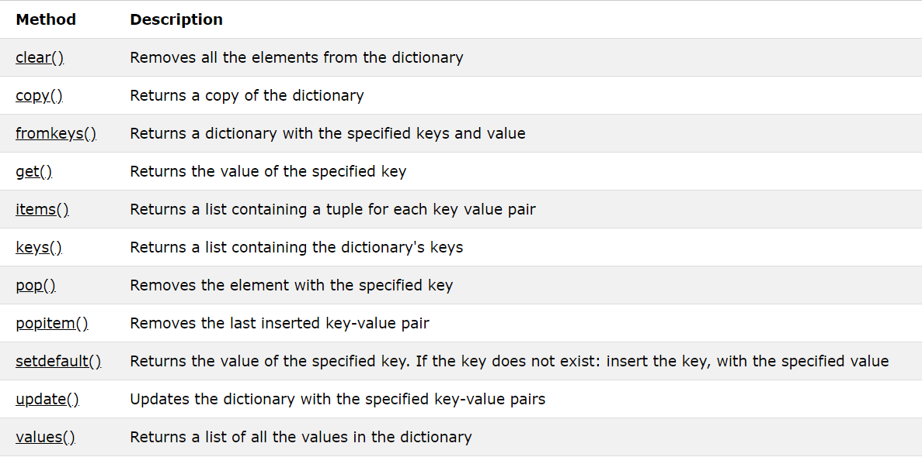
Python Dictionaries
Dictionary Methods
Python has a set of built-in methods that you can use on dictionaries.

Slide 35
THANK YOU

